Slide 1


HEALTHCARE ANALYSIS
Predicting emergency room OVERCROWDING
PRESENTED BY
SANJANA K JANGALI

Slide 2



Introduction
Content:
Objective: Analyze hospital emergency room (ER) admission trends to predict overcrowding and recommend strategies to manage patient flow efficiently.
Problem: Overcrowding in emergency rooms (Er s)affects patient care, staff efficiency, and hospital capacity.
Goal: Use data analytics to forecast demand, optimize staffing, and enhance equipment management.

Slide 3

PROJECT PROCESS
Data Sources
Data Cleaning and Preprocessing
Data Visualization
ER patient records including
Admission timestamps, waiting times, discharge details.
External factors like seasonality, public holidays, and flu outbreaks.
Ensured consistency and format for time-related columns (admit time, discharge time, etc.).
Used Python for performing Exploratory Data analysis(EDA)
Used POWER BI and PYTHON to build Dashboard and Visualization

Slide 4
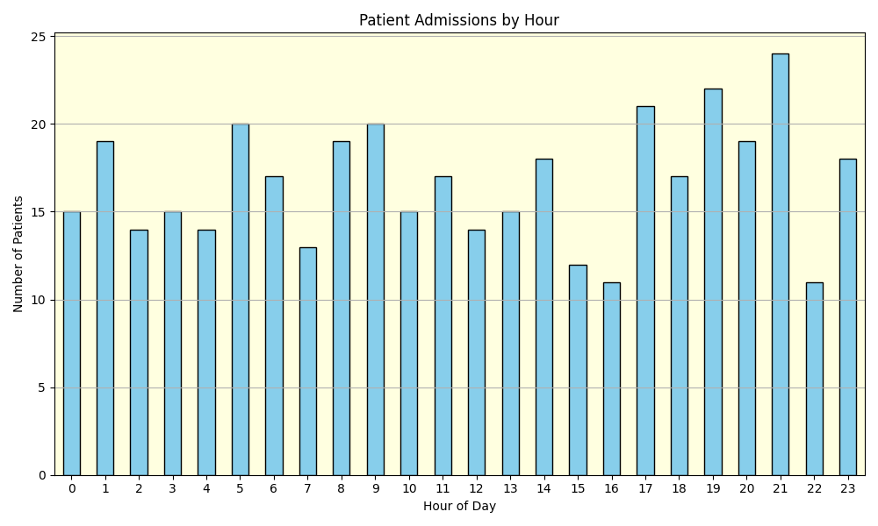
Patients Admissions by hour The highest number of patient admission occurs at 21:00 with just under 25 patients. Other high-admission hours include 19:00pm ,17:00pm,9:00am and 5:00am. The lowest admissions are observed at 16:00pm, 15:00pm and 22:00pm. Most other hours show relatively stable admission range between 14 to 20 Patients. There is a clear upward trend from 17:00 to 22:00, indicating that evening area busy period for admissions. Admissions remain fairly steady between midnight and 6:00AM , suggesting consistent overnight activity.

Slide 5
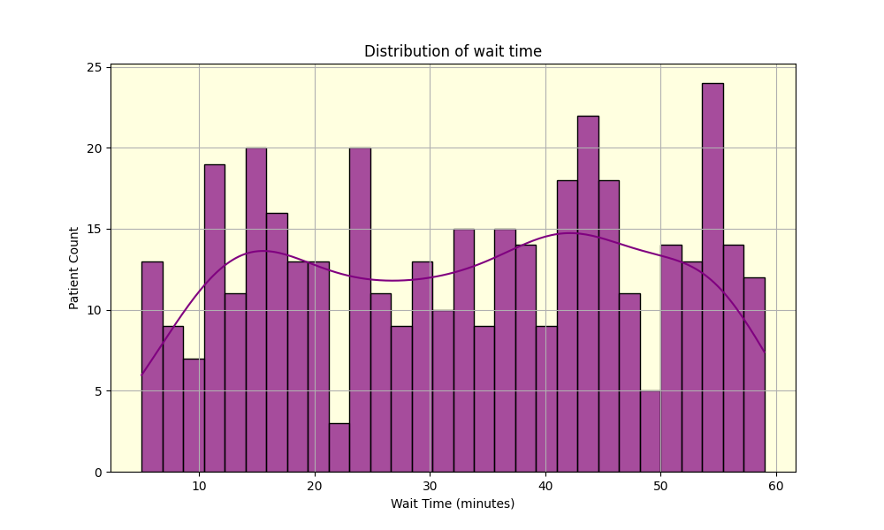
Key Insights
Wait time are spread fairly evenly patients experience a wide range of wait time from 0 to 60 minutes, with no extreme concentration in any one interval .
There are noticeable peaks in patients count around the10, 20,40- and 55-minute marks, suggesting multiple spikes in wait times, possibly due to appointment scheduling or operational delays.
KDE line suggests a slight right skew in the distribution, meaning a few patients might be experiencing longer than average waits. The highest bar appears around the 55-minutes mark, indicating that more patients waited close to an hour than at any other specific interval.

Slide 6
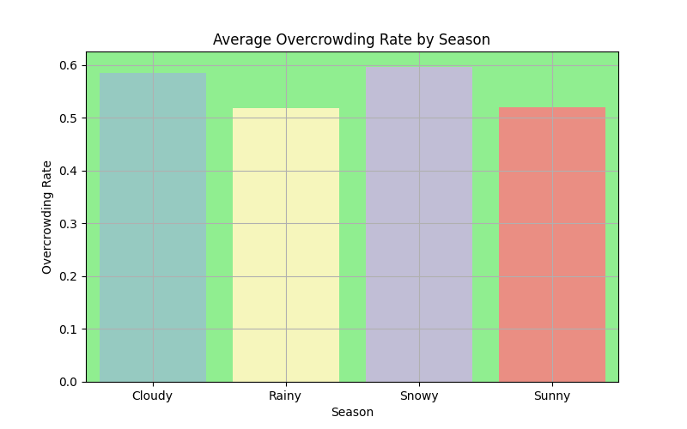
Average Overcrowding Rate by Season Snowy weather has the highest average overcrowding rate (~ 0.6).This suggest that harsh winter conditions may be linked to increased patient volume ,possibly due to seasonal illness or weather-related injuries. Rainy season has the lowest rate, slightly above 0.5,indicating potentially fewer weather-related emergencies compared to winter. Both cloudy and sunny season have moderate overcrowding rates, roughly around 0.55. These seasons might not have as snowy weather. Hospital administrators can use this data to anticipate higher demand in winter, helping in better resource planning and staffing.

Slide 7
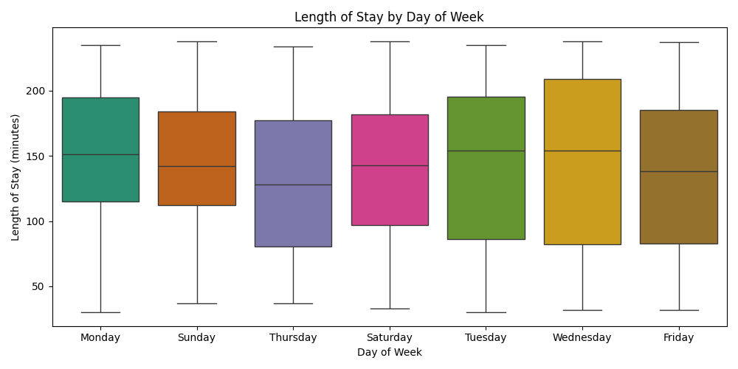
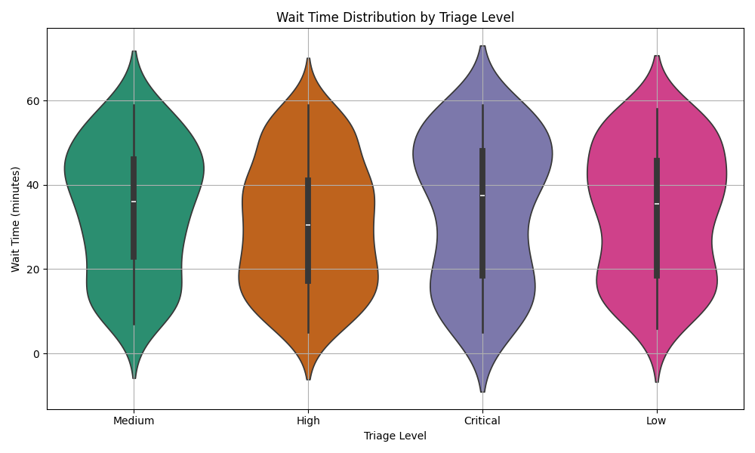
Length of Stay by Week Waiting Time by Triage level
Median wait times are similar across all triage levels(approx. 30-40 minutes).
Wide range of wait times observed in all categories, up to ~65 minutes.
High and critical levels show more variability, indicating inconsistent response times.
Medium and low levels appear more consistent around the median.
Wait times are not well-aligned with urgency, suggesting a need to improve triage prioritization or resource allocation.
Longest median stays occur on Tuesday and Wednesday(160+ minutes).
Shortest median stays are seen on Thursday and Saturday (below 140 minutes).
Monday to Friday show a wider range and variability in stay duration.
All days have similar minimum and maximum stay ranges(~25 to ~225 minutes).
Wednesday and Tuesday show the highest variability. Indicating inconsistent durations.
Potential efficiency on Saturday and Thursday due to lower median and tighter spread

Slide 8
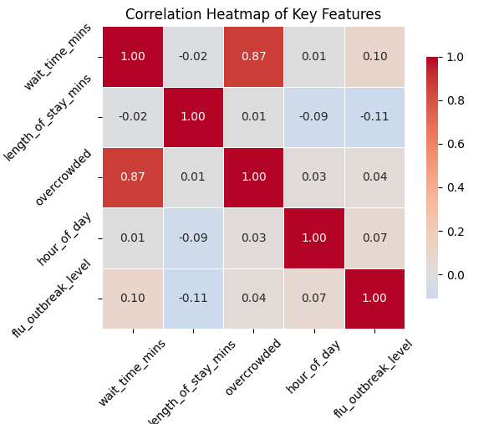
Correlation Matrix Heatmap
Focus on Reducing Wait Times since wait times are strongly correlated with overcrowding, reducing wait times can help alleviate overcrowding issues.
Flu Outbreak Preparedness while flu outbreaks have a weak correlation with wait times, proactive measures during outbreaks can prevent further delays.
The hour of admission does not significantly impact wait times or overcrowding, suggesting that other factors (e.g., patient volume, staffing) play a larger role.

Slide 9
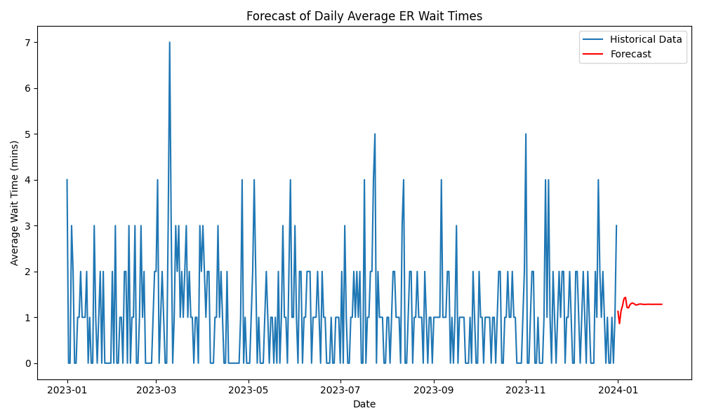
Historical Data vs Forecasted *The blue line shows the actual waiting times. It keeps going up and down a lot with sudden spikes. which means patients visits are unpredictable. *The red line is the forecast(prediction).It goes up and down as much, which means the model is trying to guess a stable trend. But it might predict waiting times slightly higher than reality.

Slide 10
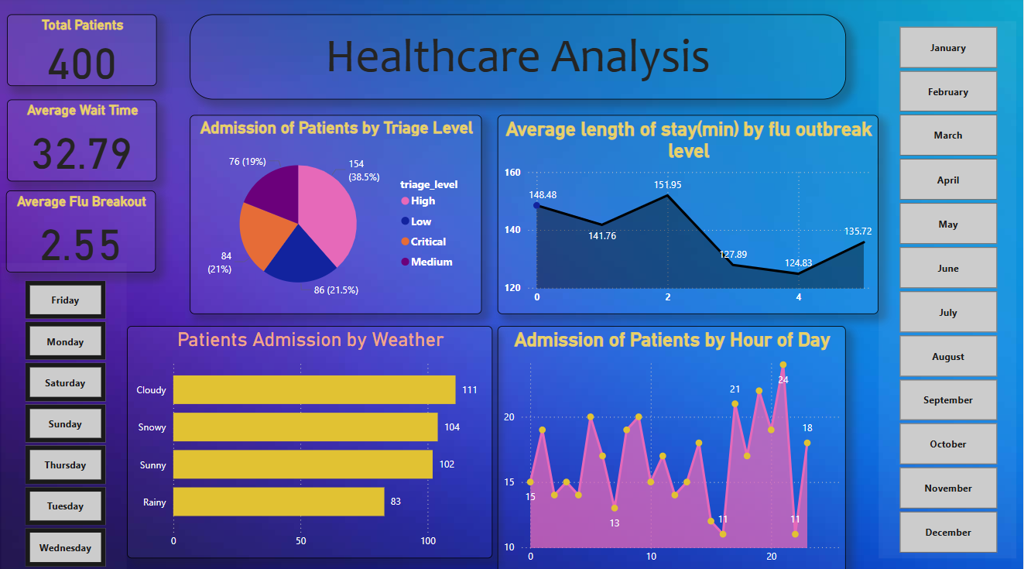
Data Visualization and Dashboard(POWER BI)

Slide 11
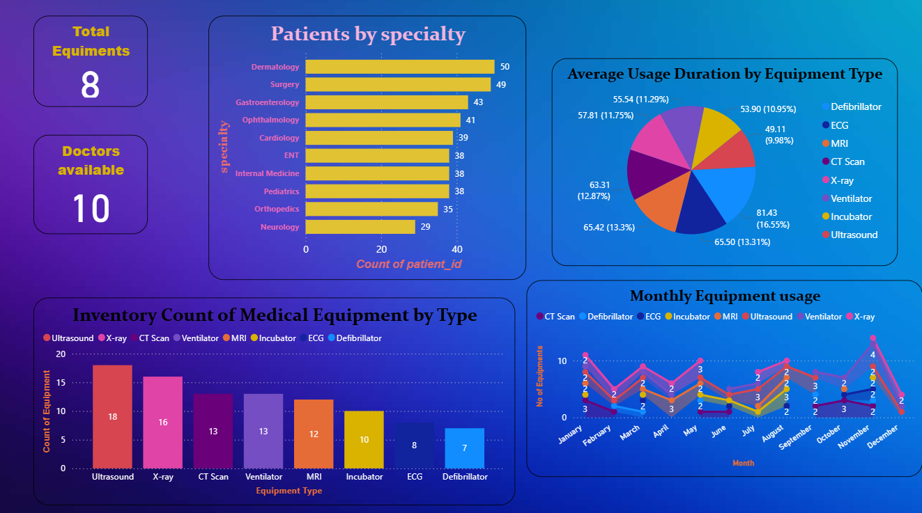
.

Slide 12
1. Total patients A total of 400 patients were analyzed in this dataset. This provides the scope of the analysis and can be used to assess resource utilization. 2. Average wait time the average wait time is 32.79 minutes. This indicates the typical waiting period for patients. If this is higher than acceptable, operational improvements may be needed. 3. Average flu breakout the average flu breakout level is 2.55.This suggests moderate flu activity, which could impact patient admissions and wait times. 4. Admission of patients by triage level the majority of patients fall into the high triage level, indicating a significant number of moderately severe cases. Resource allocation should prioritize these levels. 5. Average length of stay by flu outbreak level length of stay decreases as the flu outbreak level increases, except for a slight rise at level 4. The highest length of stay is 151.95 minutes at flu level 2. Actionable insight: during higher flu outbreak levels, patients may be discharged faster to manage overcrowding. This trend should be monitored to ensure patient care quality. 6. Patients admission by weather weather conditions impact patient admissions. Cloudy weather sees the highest admissions, possibly due to increased respiratory issues or other weather-related factors. 7. Admission of patients by hour of day admissions peak in the evening, suggesting the need for higher staffing and resources during these hours. 8. Day-specific insights the dashboard allows filtering by specific days (e.g., Friday, Monday) to analyze trends for each day of the week. This can help identify day-specific patterns in admissions, wait times, or overcrowding.

Slide 13
RECOMMENDATIONS:
Increase staffing levels and on-call support during evening shifts to handle higher patient volumes and reduce wait times.
Allocate additional beds and personnel during moderate flu outbreaks to manage longer patient stays and avoid bottlenecks.
Prepare for increased admissions during cloudy weather.
Investigate ways to reduce the average wait time of 32.79 minutes.
Monitor patient care quality during high flu outbreak levels, as length of stay decreases.
Trend monitoring : use the day-specific filters to identify patterns and optimize operations for specific days.
Streamline triage and admission processes—consider fast-tracking low-severity cases to improve flow and satisfaction.
Prioritize resources for medium-level care while maintaining readiness for critical emergencies.
Use weather trends to anticipate changes in admission rates and adjust staffing and supplies accordingly.

Slide 14

.
.
Thank You

